Slide 1
TOUCH SKIN

Slide 2
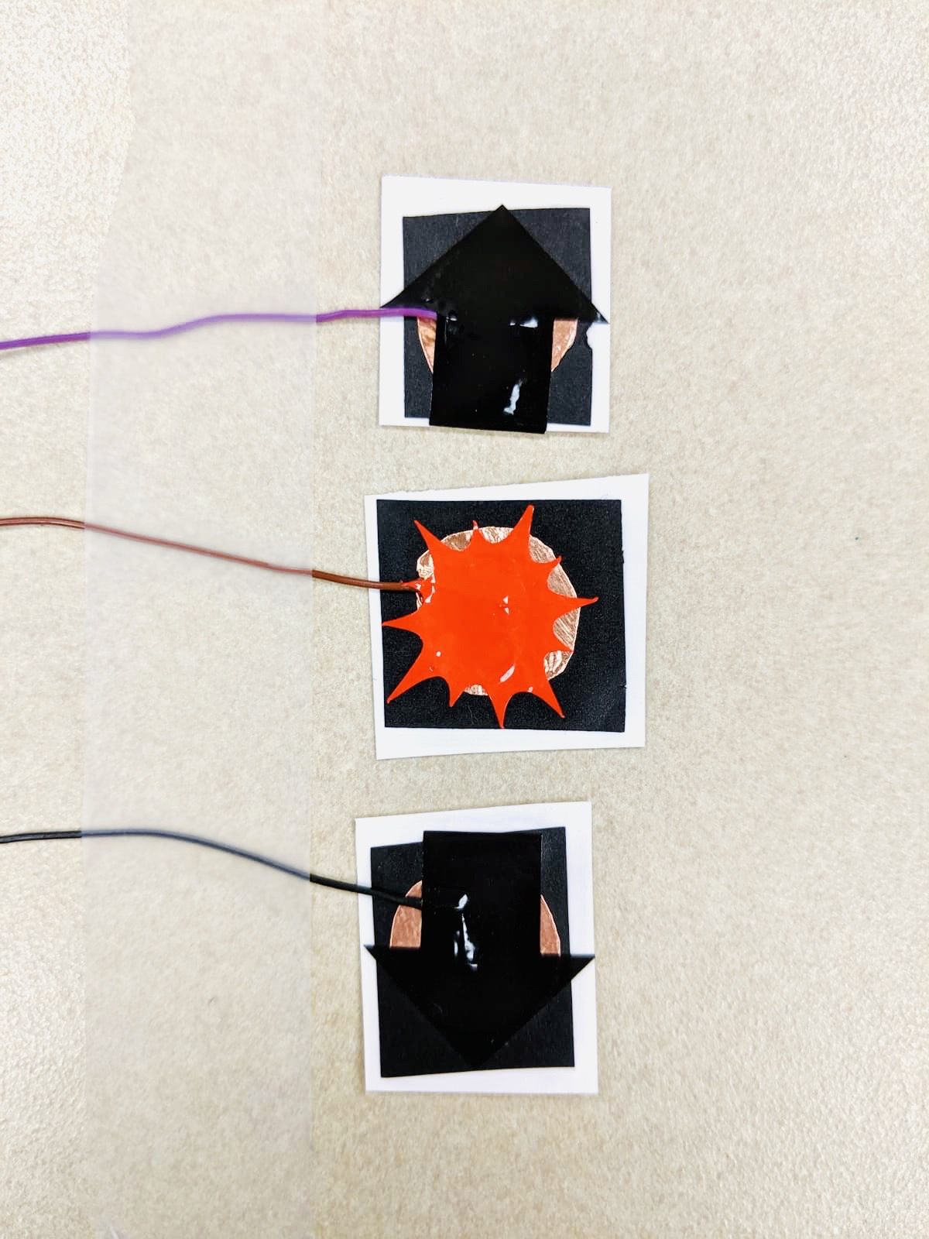
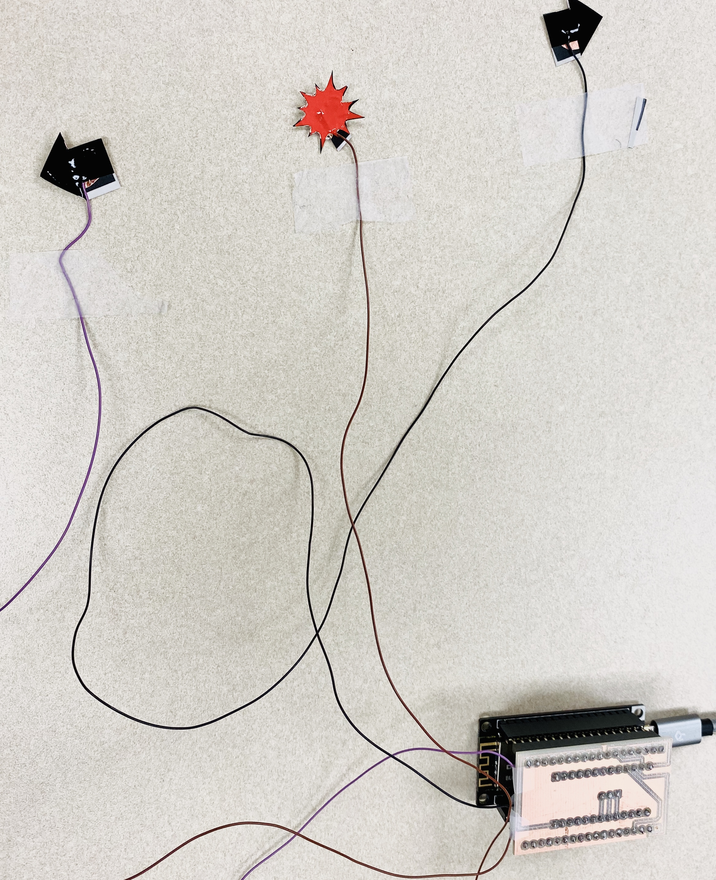
Prototyping
Capacitive buttons
Device

Slide 3
Sensors building
Main issues:
Signal saturation
→need to find the right pads size
→round shape was preferred
Cross-talking:
→need to find correct wires configurations
→Wire-pad soldering

Slide 4
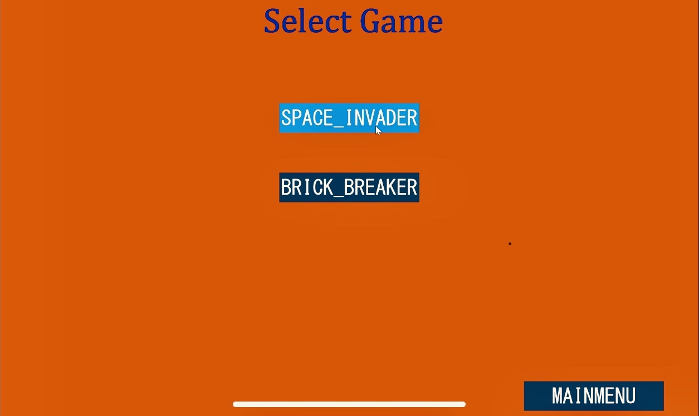
GUI design

Slide 5
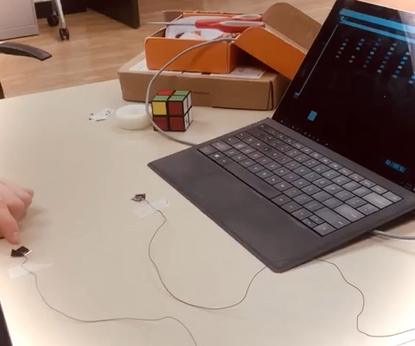
BRICK_BREAKER DEMO
Main issues:
Reducing noise
Graphic dynamical feedback optimization

Slide 7
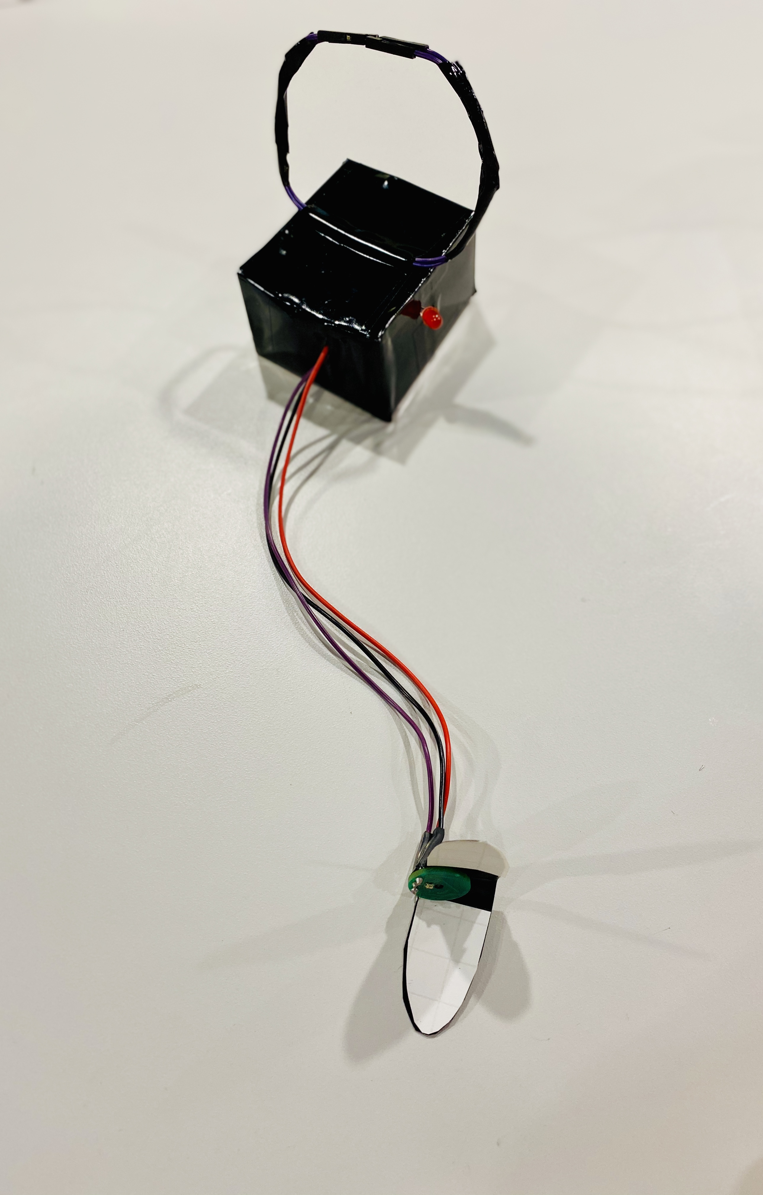
Final Device
→

